Slide 1
Empowering accessibility

Slide 2
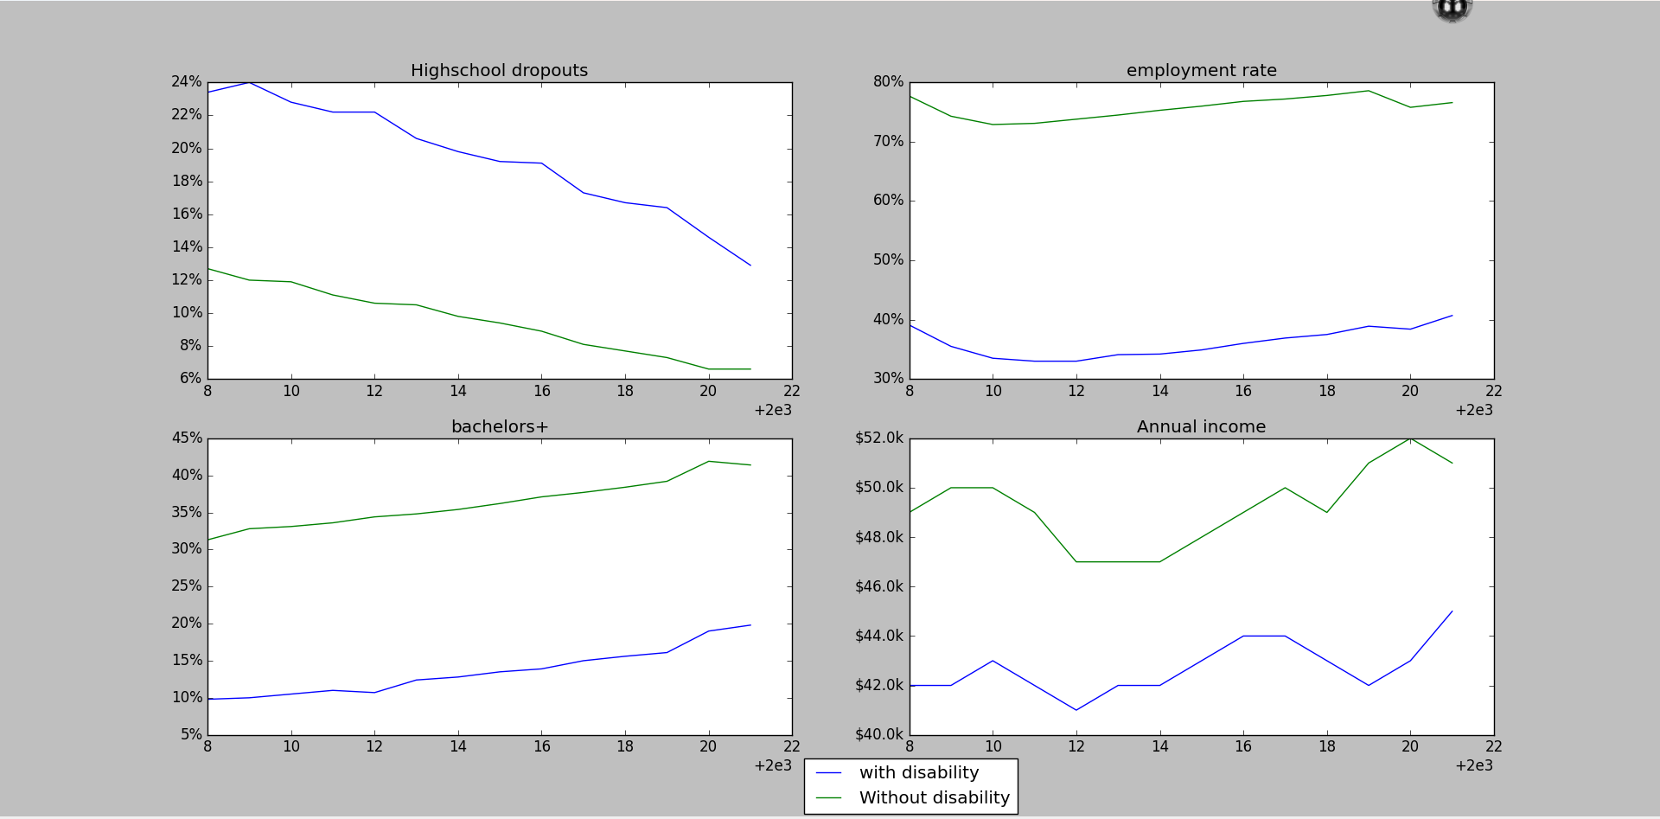
Statistics

Slide 3
Modules:
Hand movement
Voice commands
Eye/iris movement

Slide 4
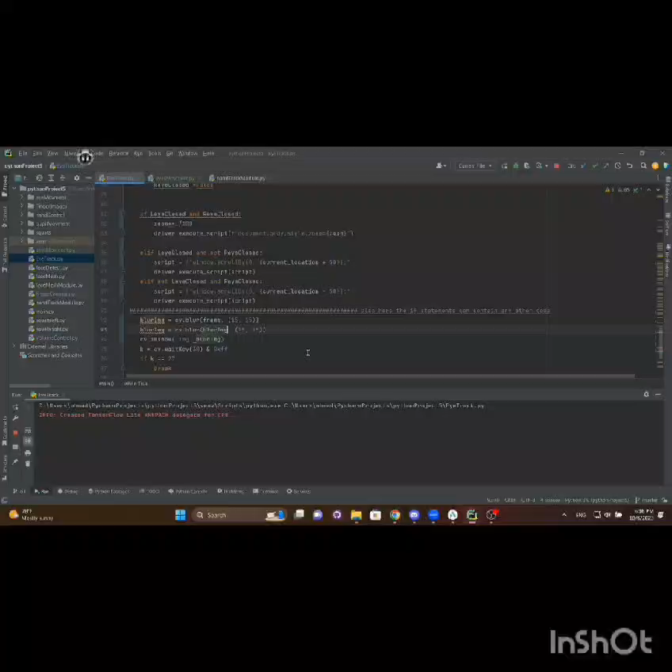
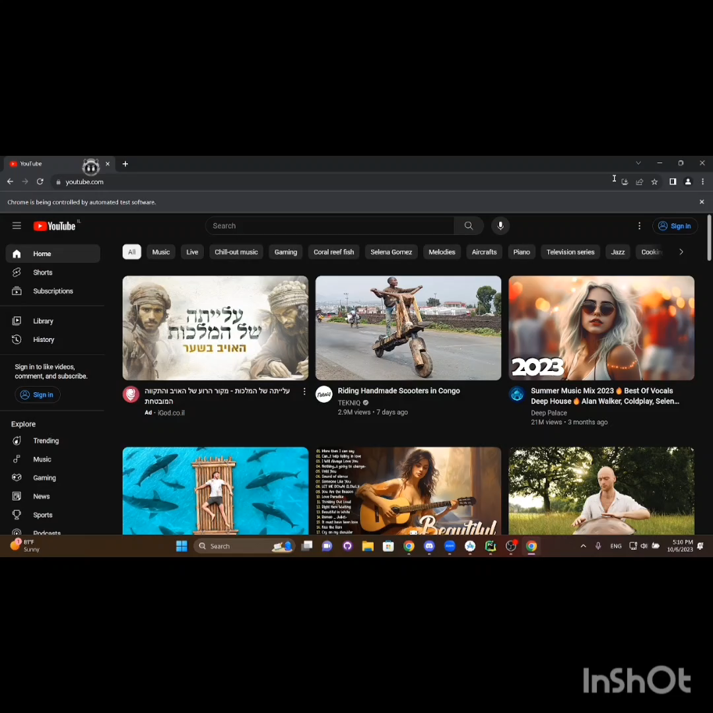
prototypes

